Slide 1
DV1C04 Deployt & Monitoring in DevOps
L01
Introduction to DevOps Deploy

Slide 2
Learning Objectives
Describe focuses of Deploy Phase
Describe overview of Deploy Phase
Identify considerations in Deploy management
Identify tools for Deploy Phase

Slide 3
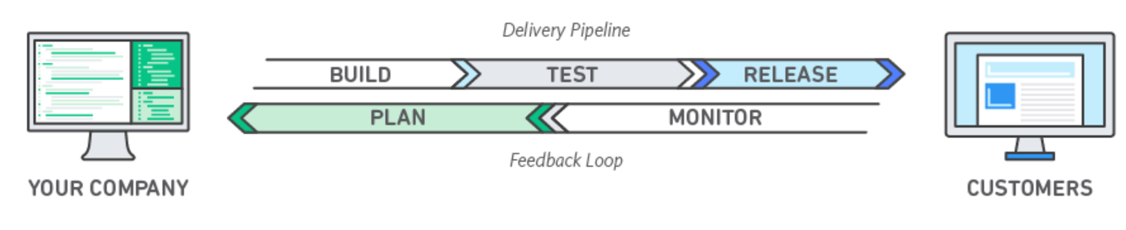
DevOps
DevOps increases an organization’s ability to deliver applications and services at high speed. It improves products at a faster pace than to use traditional software development and infrastructure management processes. DevOps enables organizations to serve customers better, and compete more effectively in the market.
Source: https://aws.amazon.com/devops/what-is-devops

Slide 4
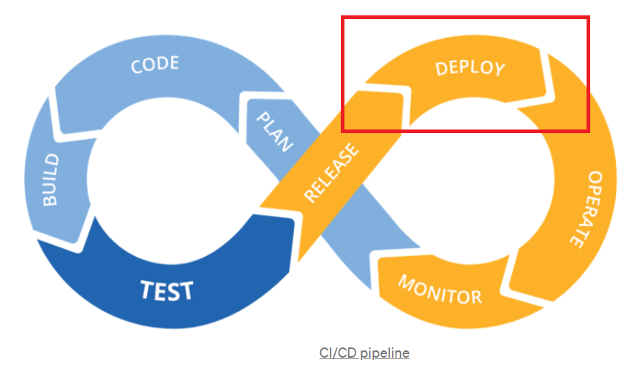
Deploy Phase
Source: https://towardsdatascience.com/ci-cd-pipeline-with-azure-devops-for-data-science-project-f263586c266e

Slide 5
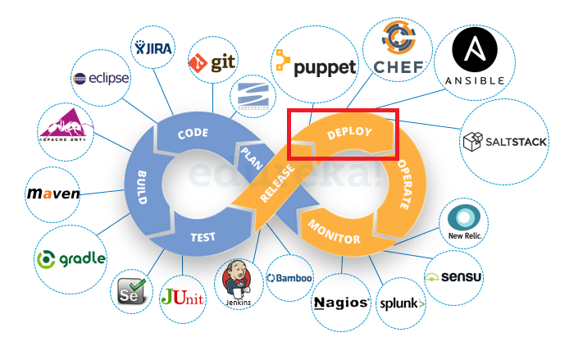
Deploy Phase
Source: https://www.edureka.co/blog/devops-lifecycle/

Slide 6
What is Deploy Phase in DevOps
When a build is ready for prime time, it is put into production.
There are a number of tools and methods that can be used to automate the release process and ensure that releases are reliable and have no downtime.
The production environment can be built using the same Infrastructure-as-Code that was used to develop the test environment.
We already know the test environment was constructed successfully, so we can be certain that the production release will proceed well.
Source: https://medium.com/taptuit/the-eight-phases-of-a-devops-pipeline-fda53ec9bba

Slide 7
What is Deploy Phase in DevOps
We need to publish the code to our servers now that it has been produced and tested so that our clients may use the newly developed capabilities.
Deployment is the process of transferring the project from its current state to the production environment for end-users to use.
The consumer/user receives the approved changes at this phase.

Slide 8
Deployment Strategies
Deployment strategies specify how you want your program to be delivered.
Depending on their business strategy, several deployment strategies are used.
One may prefer to deploy completely tested software, while others may want their users to contribute input and evaluate items that are still in development.
Source: https://www.opsmx.com/blog/advanced-deployment-strategies-devops-methodology/

Slide 9
Deployment Strategies
There are FIVE (5) different types of application deployment strategies used in DevOps methodology.
Canary Deployment
Blue-Green Deployment (sometimes known as red-black)
Recreate Strategy (highlander)
Shadow Deployment
A/B testing Deployment strategy
Source: https://www.opsmx.com/blog/advanced-deployment-strategies-devops-methodology/

Slide 10
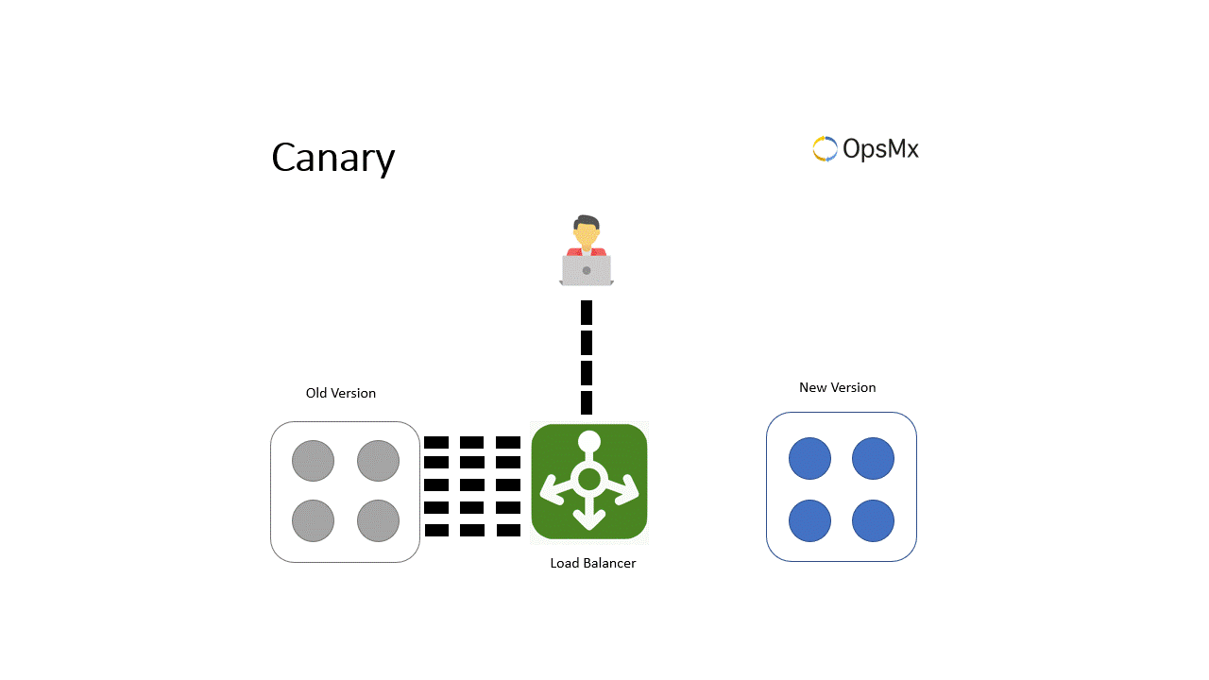
Canary Deployment
Canary deployment is a method of reducing the risk of delivering a software update into production by gradually introducing the change to a small subset of users before making it available to everyone.
The goal is to collect data from a small number of users in order to forecast the outcome of a full-scale production deployment.
Source: https://www.opsmx.com/blog/advanced-deployment-strategies-devops-methodology/

Slide 11
Canary Deployment
Advantages | Disadvantages
This allows developers the freedom to test new features and the confidence to deploy and test them. We have a quicker rollback process now. This is something I can do with a small amount of infrastructure. When developers want to carry out modest, progressive changes, this is the best option. | It takes a long time to deploy and has a slow rollout speed. To avoid errors, the platform must be equipped with automatic deployments. Processes relying on scripts are not encouraged.
Source: https://www.opsmx.com/blog/advanced-deployment-strategies-devops-methodology/

Slide 12
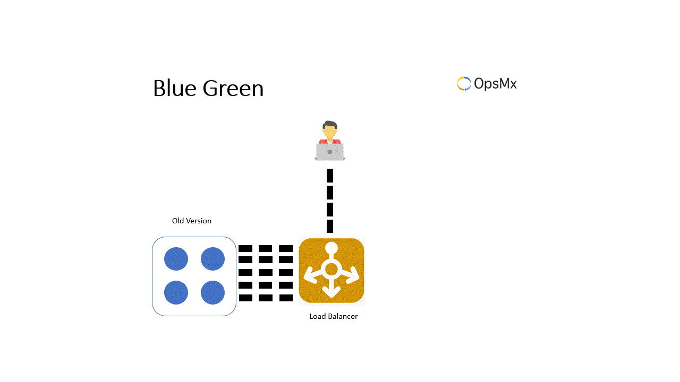
Blue-Green Deployment Strategy
A Blue-Green deployment method is one in which the old and new instances of an application or microservice run in parallel in production at the same time, with a load balancer automatically switching traffic from the older to the newer version.
The plan is to keep the previous version as a backup and run it alongside the new version at all times.
Source: https://www.opsmx.com/blog/advanced-deployment-strategies-devops-methodology/

Slide 13
Blue-Green Deployment Strategy
Advantages | Disadvantages
Instant rollback feature. There are no clients using a different version of the application at any one time. No version issues. | High Infrastructure Costs With this method, small update rollouts may not be cost-effective.
Source: https://www.opsmx.com/blog/advanced-deployment-strategies-devops-methodology/

Slide 14
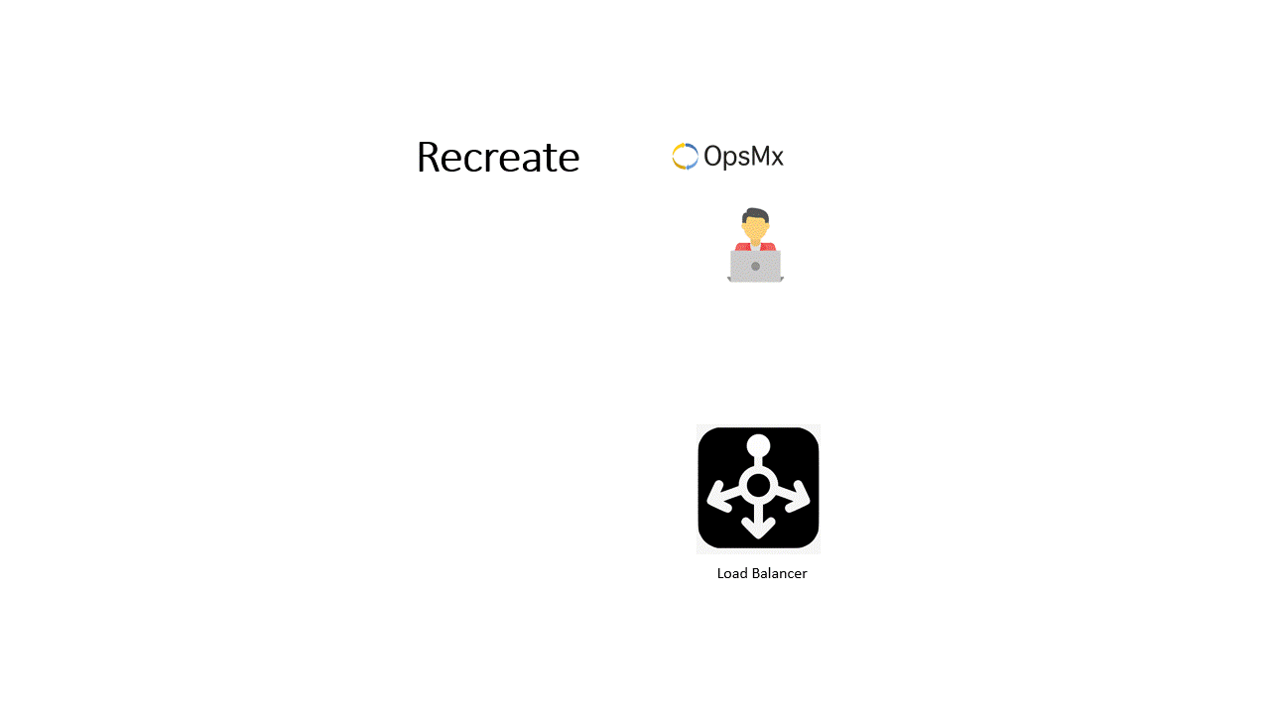
Recreate Deployment Strategy
The Recreate deployment technique is a basic deployment approach in which the older version must be shut down before the newer version can be deployed.
After shutting down, it delete the outdated version and deploy the updated version.
Source: https://www.opsmx.com/blog/advanced-deployment-strategies-devops-methodology/

Slide 15
Recreate Deployment Strategy
Advantages | Disadvantages
Simple to set up. It is not necessary to keep a N+1 database schema and application compatibility. Without the need of a load balancer. | Reboot and disk write speeds will have a significant impact on downtime. Users will be affected for a long period.
Source: https://www.opsmx.com/blog/advanced-deployment-strategies-devops-methodology/

Slide 16
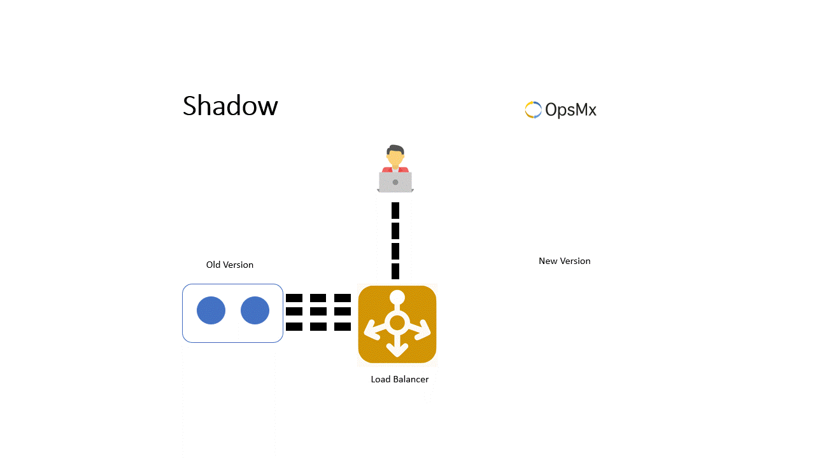
Shadow Deployment Strategy
A shadow deployment approach is one in which the new version is available alongside the old version in anticipation, but traffic to the older version is copied or forked to the new version for production testing. Following satisfactory traffic and load testing, the latest version is deployed out.
It runs a simulated application in parallel with the real one. For performance testing in a real-world setting, the dummy application receives a copy of the actual production traffic.
Source: https://www.opsmx.com/blog/advanced-deployment-strategies-devops-methodology/

Slide 17
Shadow Deployment Strategy
Advantages | Disadvantages
The accuracy of the performance and stability testing is very high. | It has high infrastructural expenses. It needs to be able to scale infrastructure quickly in response to demand. Some services, such as payment gateways, will have to be mocked. The entire setup will be difficult. It does not offer a reliable test of user behavior.
Source: https://www.opsmx.com/blog/advanced-deployment-strategies-devops-methodology/

Slide 18
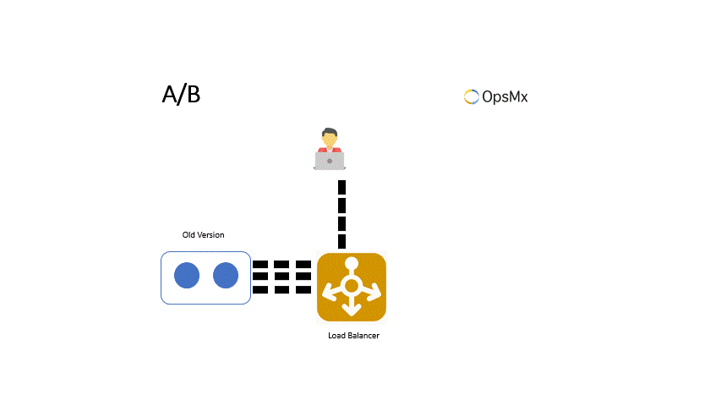
A/B Testing Deployment Strategy
The rollout or rollback of an A/B testing deployment plan is based on real-world statistical data. It entails sending a subset of people to a new feature or capability under certain circumstances, then obtaining data about this group of users to compare to the overall average of the previous version.
Test the new functionality with a specific group of users (not at random), based on common user characteristics such as region or device type.
Source: https://www.opsmx.com/blog/advanced-deployment-strategies-devops-methodology/

Slide 19
A/B Testing Deployment Strategy
Advantages | Disadvantages
It runs numerous AB tests in parallel, so it can test multiple versions at the same time. It makes decisions using real-world statistical data. It does a thorough analysis of user behavior. | It necessitates the use of a costly and clever load balancer. In comparison to other tactics, the process is extremely complex.
Source: https://www.opsmx.com/blog/advanced-deployment-strategies-devops-methodology/

Slide 20
Tools for Deploy Phase
Tools to organize, coordinate, schedule, and automate product releases into production can be included at this phase.
Puppet, Chef, Ansible, Jenkins, Kubernetes, OpenShift, OpenStack, Docker, or Jira are some examples of tools.
Source: https://www.netapp.com/devops-solutions/what-is-devops/

Slide 21
Infrastructure as Code
Infrastructure as code is a term that has recently gained popularity to underline the need of treating infrastructure setup in the same way that you would treat code development.
This entails selecting the appropriate language or tool for the job and developing a solution that meets your requirements, resulting in an executable specification that can be deployed to target systems quickly and often.

Slide 22
The benefits of IaC
The standardization of infrastructure configuration decreases the possibility of mistakes.
The infrastructure code is versioned and controlled through a source control system.manager of code.
The code is integrated into continuous integration and delivery (CI/CD) pipelines.
Infrastructure-related deployments are more efficient and faster.
There is better administration, control, and infrastructure cost reduction.

Slide 23
IaC languages and tools
The infrastructure can be coded using a variety of languages and techniques, including scripting and declarative types.
Scripting types
These are scripts written in languages such as Bash, PowerShell, or any other language that make use of the cloud provider's various clients (SDKs).
Declarative types
These are languages in which writing the state of the intended system or infrastructure as configuration and properties is sufficient. Terraform, Ansible, Puppet, and Chef, for example.

Slide 24
Configuration Management
Changes in the system - the server runtime environment - are managed by configuration management (CM). Managing many servers with the same setup is a popular use case for this.
On each server, for example, we must install Apache. What if we need to update some programs, change the port on all servers, or give specific people permissions? In this circumstance, any modification is done manually, which might be a risky operation.
Because all of the servers have the same configuration, automation will be beneficial.

Slide 25
Configuration Management
CM also entails keeping track of or versions of information regarding the state of certain nodes or servers.
This can be triggered by a centralized modification, or nodes can communicate with the CM server to see whether they need to update themselves. When only modified behavior is updated, and the whole installation and modification is not applied again to the server nodes, CM tools make this procedure efficient.

Slide 26

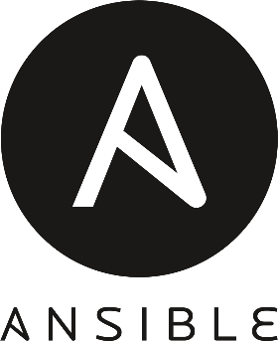
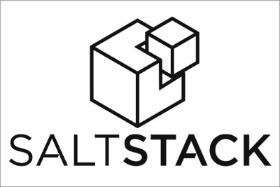

Configuration Management
There are many configuration management products on the market. Chef, Puppet, Ansible, Salt, and other popular technologies are only a few examples.
The way each tool works is different, but the characteristics and end purpose are the same: to bring standardized behavior to the state changes of specified nodes with no errors.

Slide 27
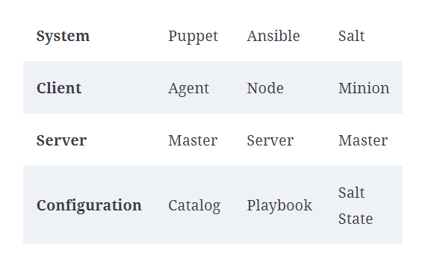
Terminology Comparison tables
Source: Practical DevOps - Second Edition by Joakim Verona (Book)
Notes:
https://www.veritis.com/blog/chef-vs-puppet-vs-ansible-comparison-of-devops-management-tools/

Slide 28
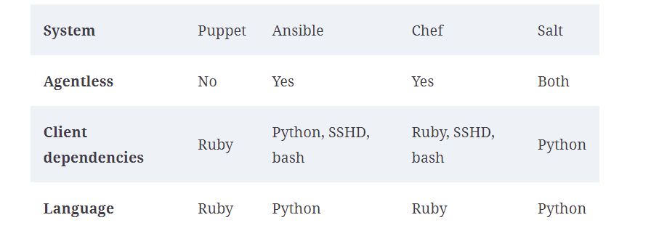
Technology Comparison tables
Source: Practical DevOps - Second Edition by Joakim Verona (Book)

Slide 29
Configuration Management
“To make error is human. To propagate error to all server in automatic way is #devops.” —DevOps Borat Source: https://twitter.com/devops_borat/status/41587168870797312

Slide 30
References
https://medium.com/taptuit/the-eight-phases-of-a-devops-pipeline-fda53ec9bba
https://www.opsmx.com/blog/advanced-deployment-strategies-devops-methodology/
https://www.netapp.com/devops-solutions/what-is-devops/
https://twitter.com/devops_borat/status/41587168870797312

Slide 31
Thank you

